Slide 1
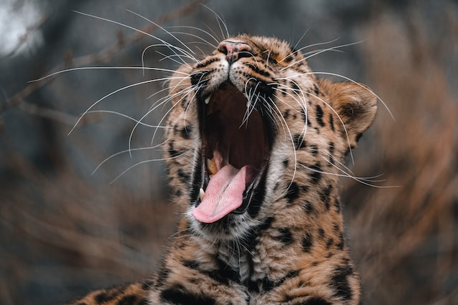
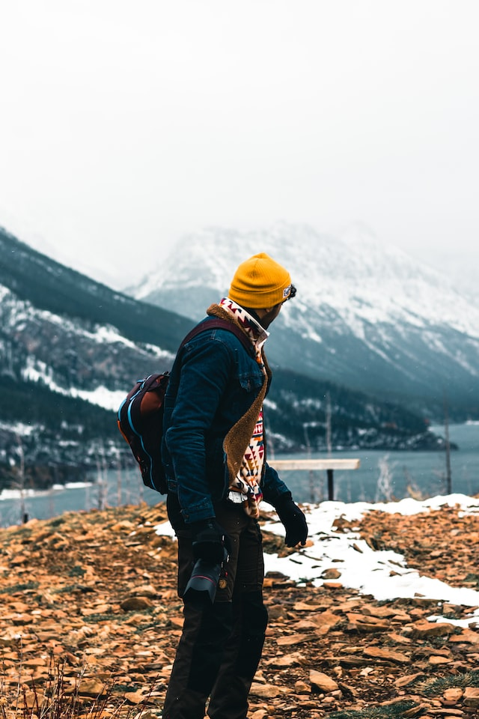
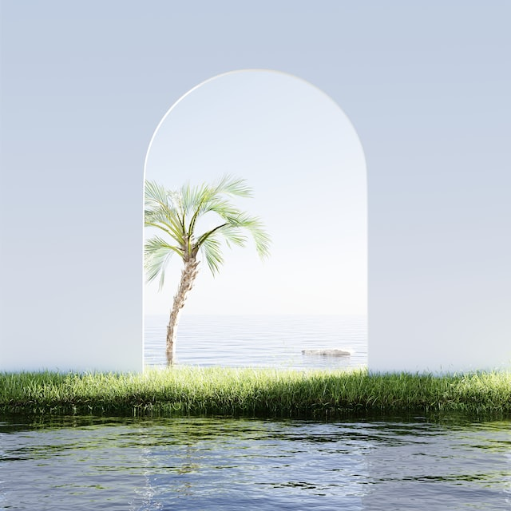
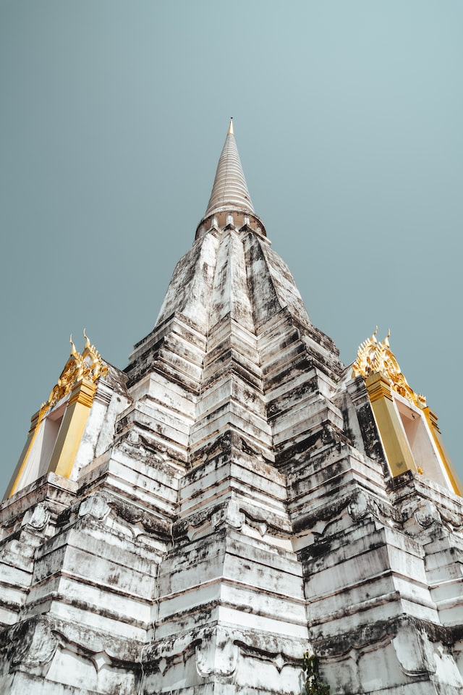
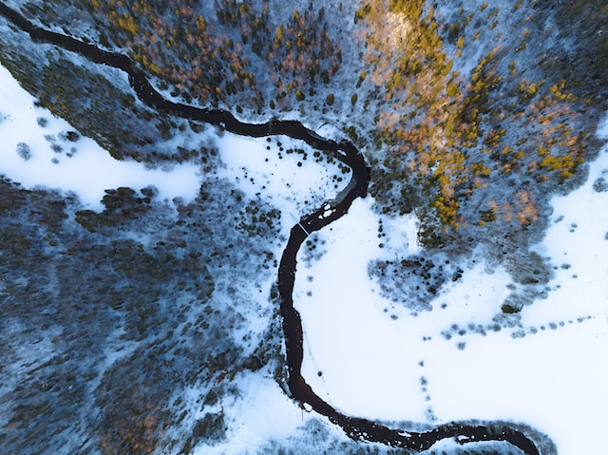
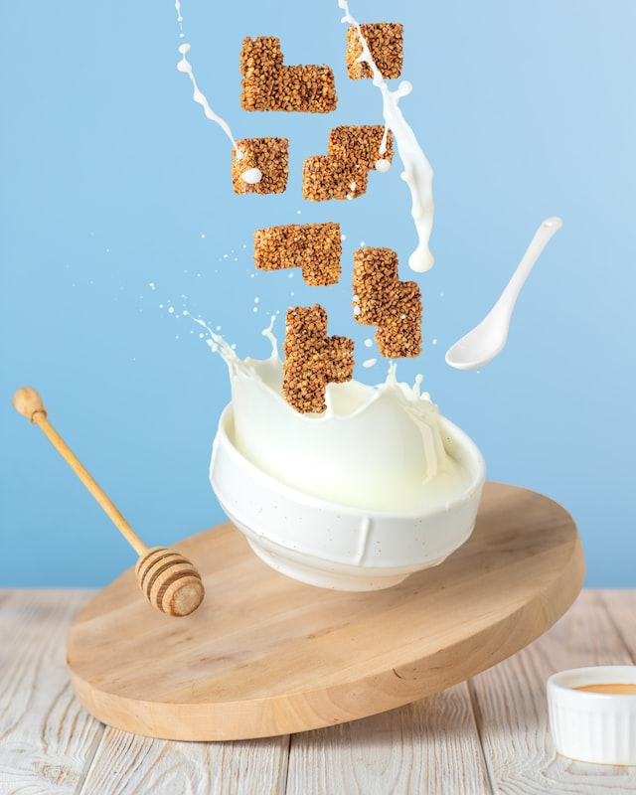
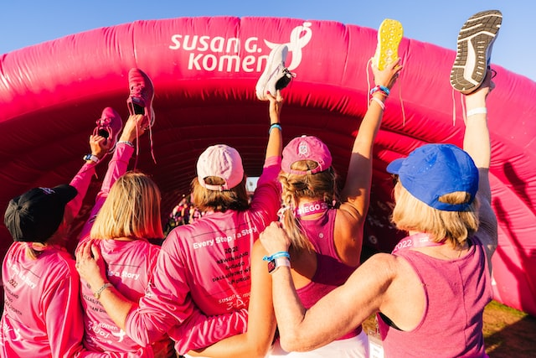
march
Events

Slide 2



march
Events

Slide 3
breakfast
I seriously wanna change my daily breakfast habits and switching it to a healthier one.
Events

Slide 4




monument
Seeking the whole bunch of monuments will be a great fun alongside the territorial view (till its under my budget).
Events

Slide 5
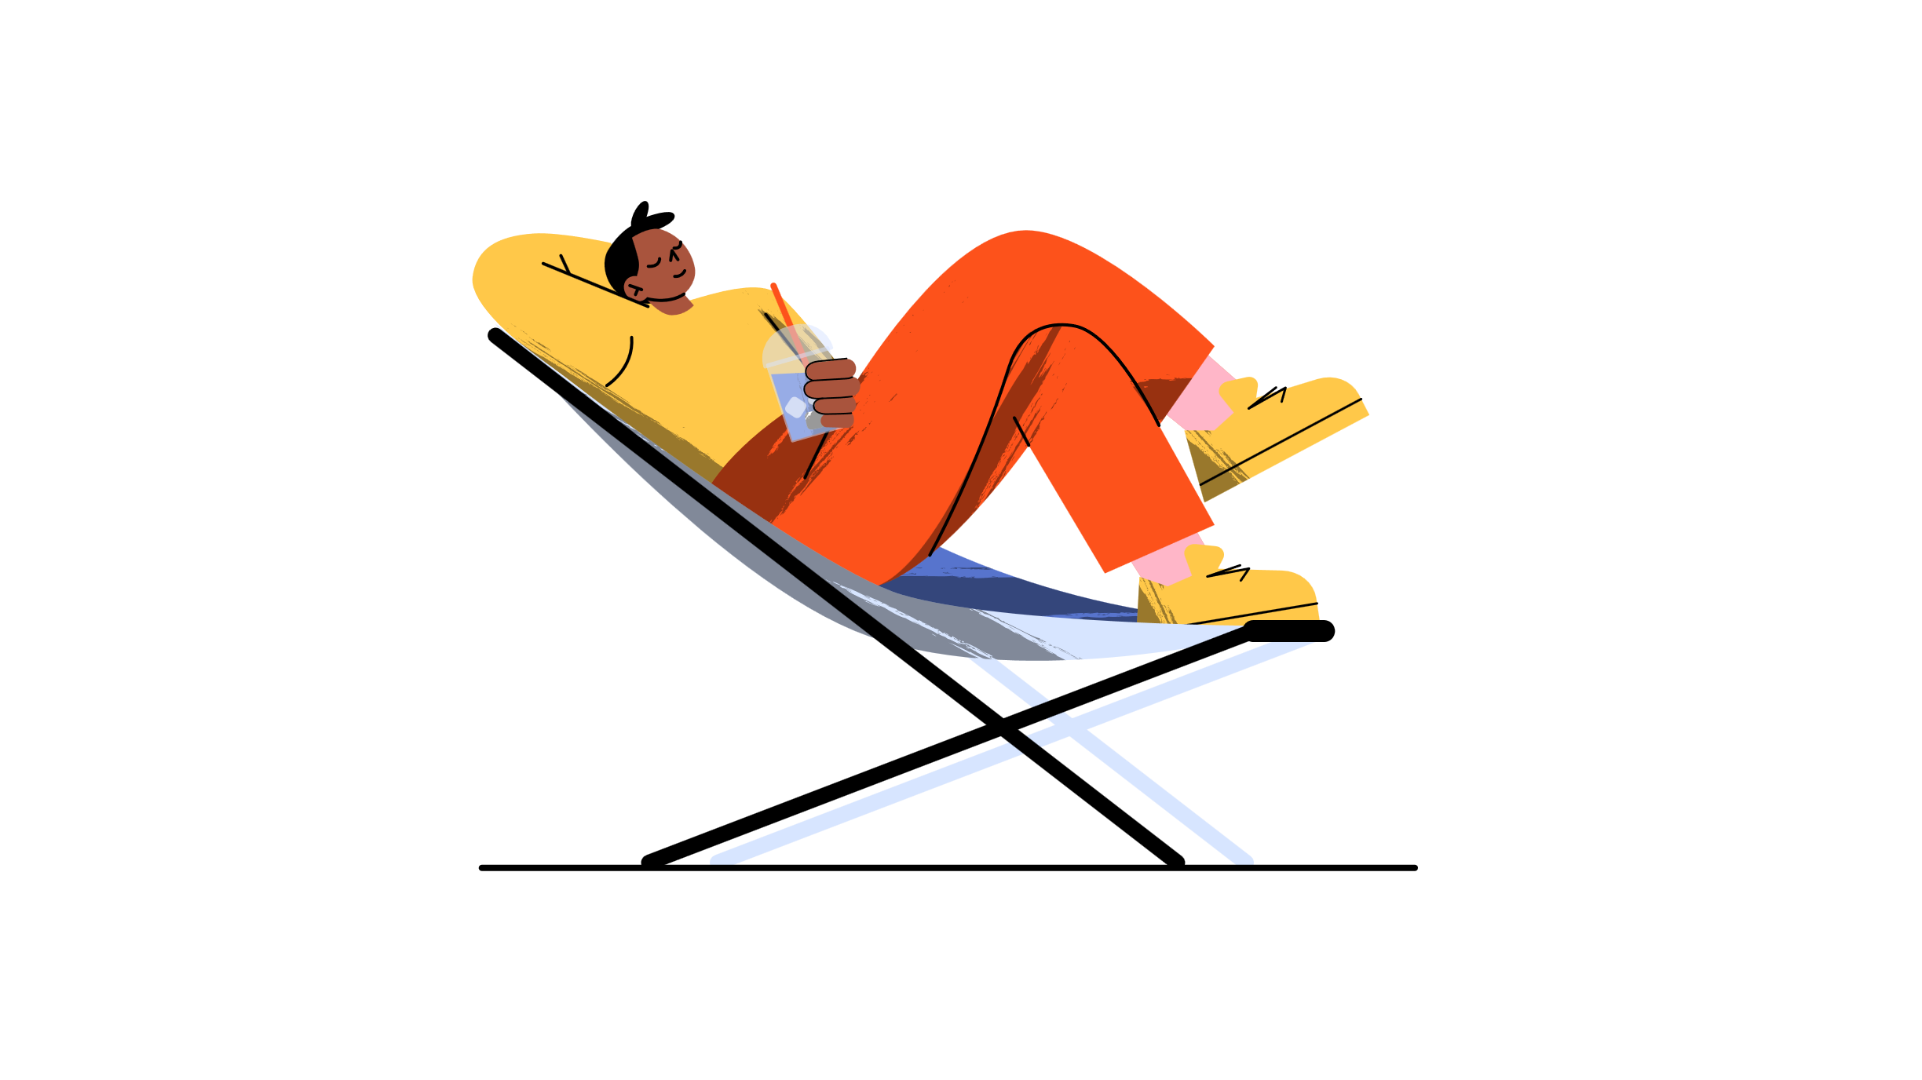
landscape
I love to explore the world and its beauty somehow fantasies me more than people.
Events

Slide 6
relaxing
Aah , this is something I really wanna do whenever I m off works (although I don’t work actually ) .
Events

